Slide 1
Team 5 Induction Heater Controller
Aaron Neuharth, John Donnell, Austin DuCrest, Dow Cox, Cole Wilson

Slide 2
Outline
Problem Formulation
Standards, Ethics, and Broader Impacts
Overview of Conceptual Design
Detailed Design

Slide 3
Background

Slide 4
Problem Statement
Design and prototype an induction coil controller in such a way to heat both the internal and surface level material of a circular heating element

Slide 5
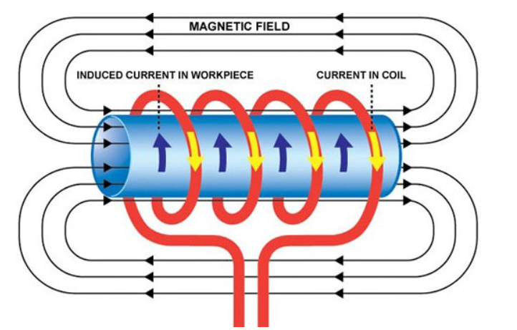
Notes:
apply current to coil
coil generate magnetic field
magnetic field induce voltage on workpiece

Slide 6


Key Stakeholders
Tennessee Technological University
Lochinvar

Slide 7
Key Stakeholders
Tennessee Technological University
  TTU is primarily concerned about
providing an educational experience
without sacrificing safety.
  TTU provides a budget of $1k

Slide 8
Key Stakeholders
Lochinvar
  Lochinvar acts as the customer for this project
  Lochinvar supplies the expertise of Ben Putnam and Daniel Rushing to ensure the project’s success
  Lochinvar provides a budget of $2k

Slide 9
Problem Formulation

Slide 10
Specifications
This controller shall have multiple power settings similar to induction cooktops
This controller shall be capable of inducing surface eddy currents and internal heating
The controller shall test circular bar stock and standard black pipe thermocouple in such a manner to validate the success of the heating
This controller shall measure total electrical power consumed
This controller shall measure the total temperature rise of the metal.

Slide 11
Constraints
Applicable NEC standards
  When the controller is set to “off” it should not be able to energize automatically and should open all ungrounded conductors
  Control Panel should be dead front construction and any accessible part of the heating equipment should not exceed 50 V

Slide 12
Constraints
The system must be able to run on a 240 Volt system to simulate a real world application.
Component temperatures must be less than 100 degrees Celsius
Entire project must stay within budget

Slide 13
Measures of Success
The controller is capable of inducing eddy currents to validate the success of heating.
Power level supplied to load is available to user on display.
Total temperature rise of the metal is measured and outputted to user.

Slide 14
Outline
Problem Formulation
Standards, Ethics, and Broader Impacts
Overview of Conceptual Design
Detailed Design

Slide 15
Standards, Ethics, and Broader Impacts
Electrical Safety
  Electric Shock Risk from the pipe and coil is relatively low, but risk remains from the power supplied to the coil
Thermal Safety
  Induction heating can reach very high temperatures very quickly, which makes the heat of the pipe a concern.
Proper isolation of the workpiece and people is needed to mitigate risk of injury.

Slide 16
Standards, Ethics, and Broader Impacts
Electrical and Thermal Solutions
  These concerns are primarily addressed by providing a nonconducting enclosure to reduce the risk of shock and burns. (NEC Article 665)
PCB Standards
  Proper spacing, labeling, and layered isolation on the PCB are required to prevent electrical shock, arcing, and ensure safe operation
Parts need to be available from multiple vendors to prevent any supply chain risk issues

Slide 17
Outline
Problem Formulation
Standards, Ethics, and Broader Impacts
Overview of Conceptual Design
Detailed Design

Slide 18
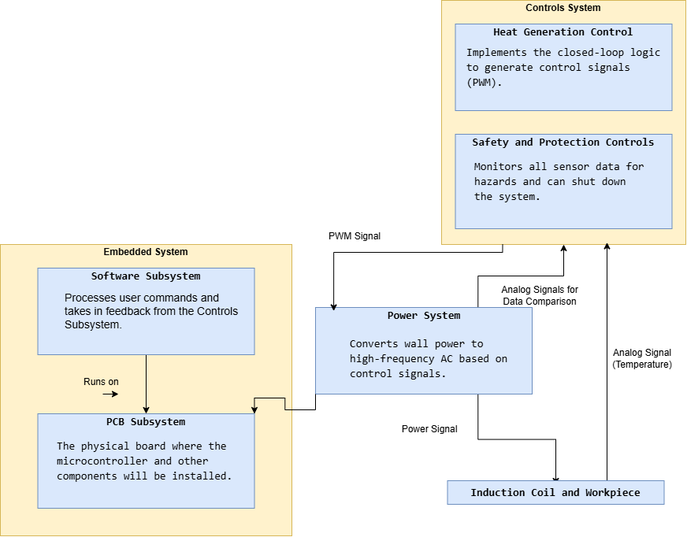
Conceptual Design

Slide 19
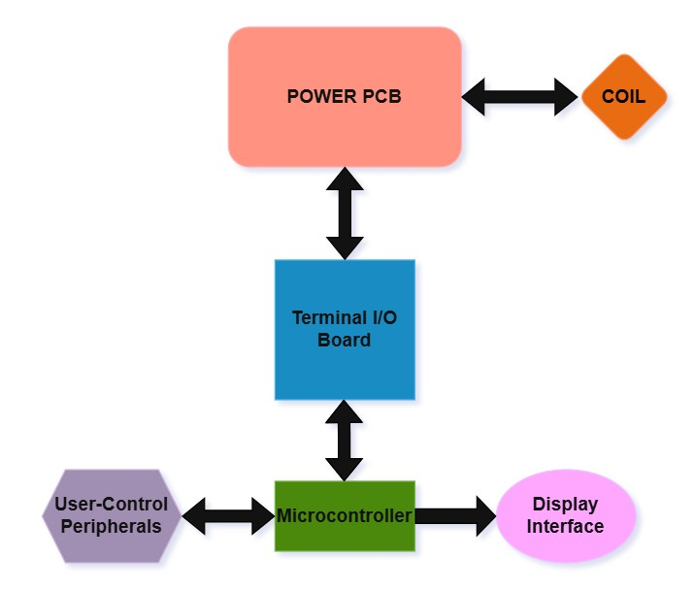
Hardware Block Diagram
Separate subsystems for power management, I/O interface, user controls, and display
Power PCB handles power conversion and power transfer
Terminal I/O Board provides signal conditioning and interface between power and control systems
Bidirectional communication allows for real-time feedback and system monitoring

Slide 20
Outline
Problem Formulation
Standards, Ethics, and Broader Impacts
Overview of Conceptual Design
Detailed Design

Slide 21
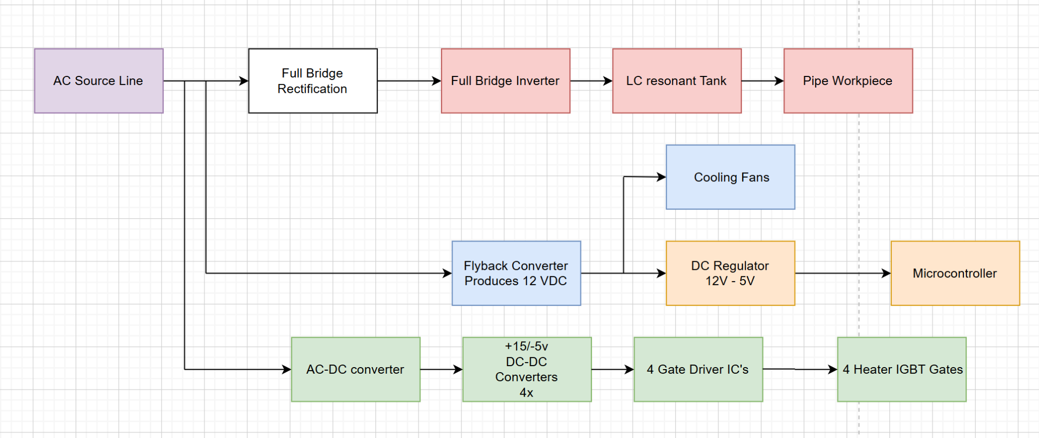
Detailed Design - Power
Proper decoupling and smoothing for input power signals to components.
Ensures All passive components receive proper voltage.
Components are selected such that they are rated to handle the nominal and spike currents that are generated within system.
Why is there a 12 and 15 VDC rail instead of combining into a single 15 VDC?

Slide 22
Detailed Design - Safety and Protections
Hybrid Design between Software and Hardware Safety Interlocks
  Hardware
    IGBT Desaturation Circuit
    Fault Latching Circuit
  Software
    Heatsink Temperature Monitoring
    Flow Rate Monitoring
    Input Current Monitoring
Split Enclosure to isolate Control signals from Power Signals
Notes:
Moving on to the Safety and Protections side of our detailed design, the Safety and Protection Controls subsystem is responsible for ensuring the induction heater operates within safe limits, protecting both the user from harm and the device from hardware damage. It functions continuously in the background, monitoring critical signals such as temperature and current. I have decided that a hybrid design between hardware and software interlocks is the best way forward. To interlock at a micro-second level, hardware circuits such as the IGBT Desaturation Circuit were designed to catch a desaturation event before damage occurs to components. For interlocks that do not require as fast of a response as desaturation, such as temperature, flow, and input current monitoring, Software is used for simplicity and cost. Despite the separation, all error signals go to the same Fault Latching Circuit that will keep the system in a fault state until system power is reset.

Slide 23
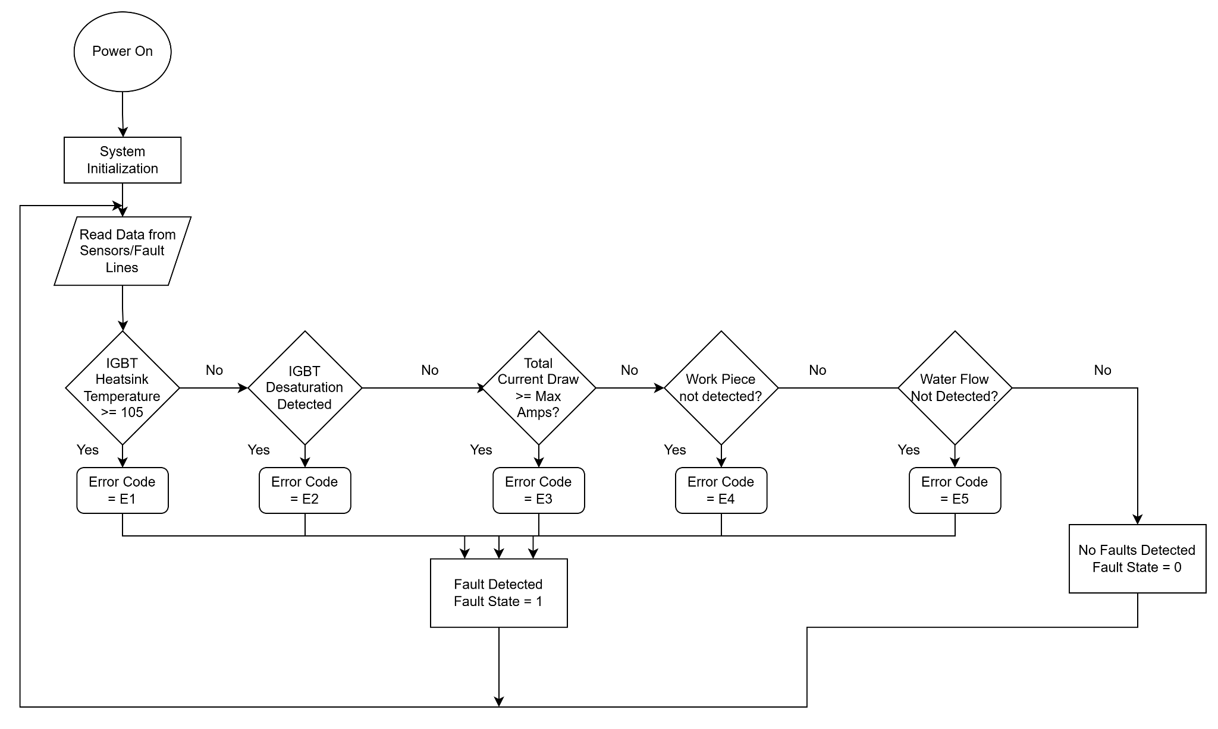
Detailed Design - Safety and Protections

Slide 24
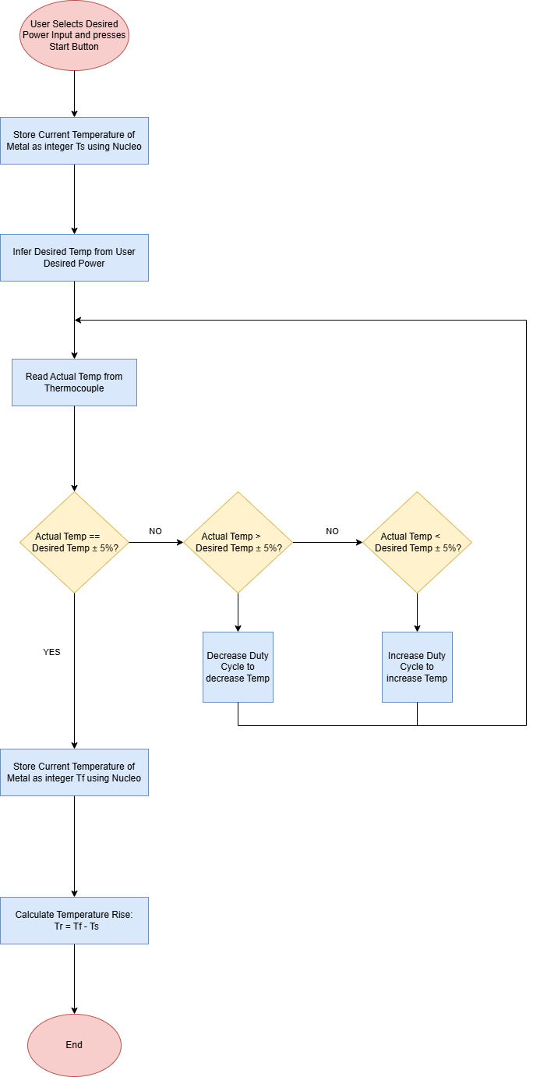
Detailed Design - Heat Generation
Notes:
meet customer spec by calculating temp rise
adjusting temp using PID and PWM signal (control current / power delivered, maybe mention variac)

Slide 25
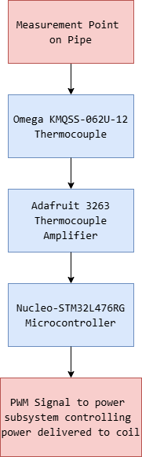
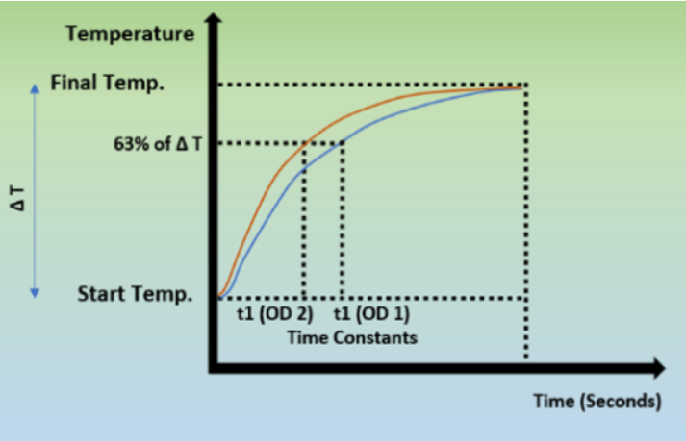
Detailed Design - Heat Generation
Notes:
temperature can be approximated as a first order system
can model the system using open loop testing (variac) and calculate the relationship between power and temp
want to make control of the pipe temp consistent and reliable

Slide 26
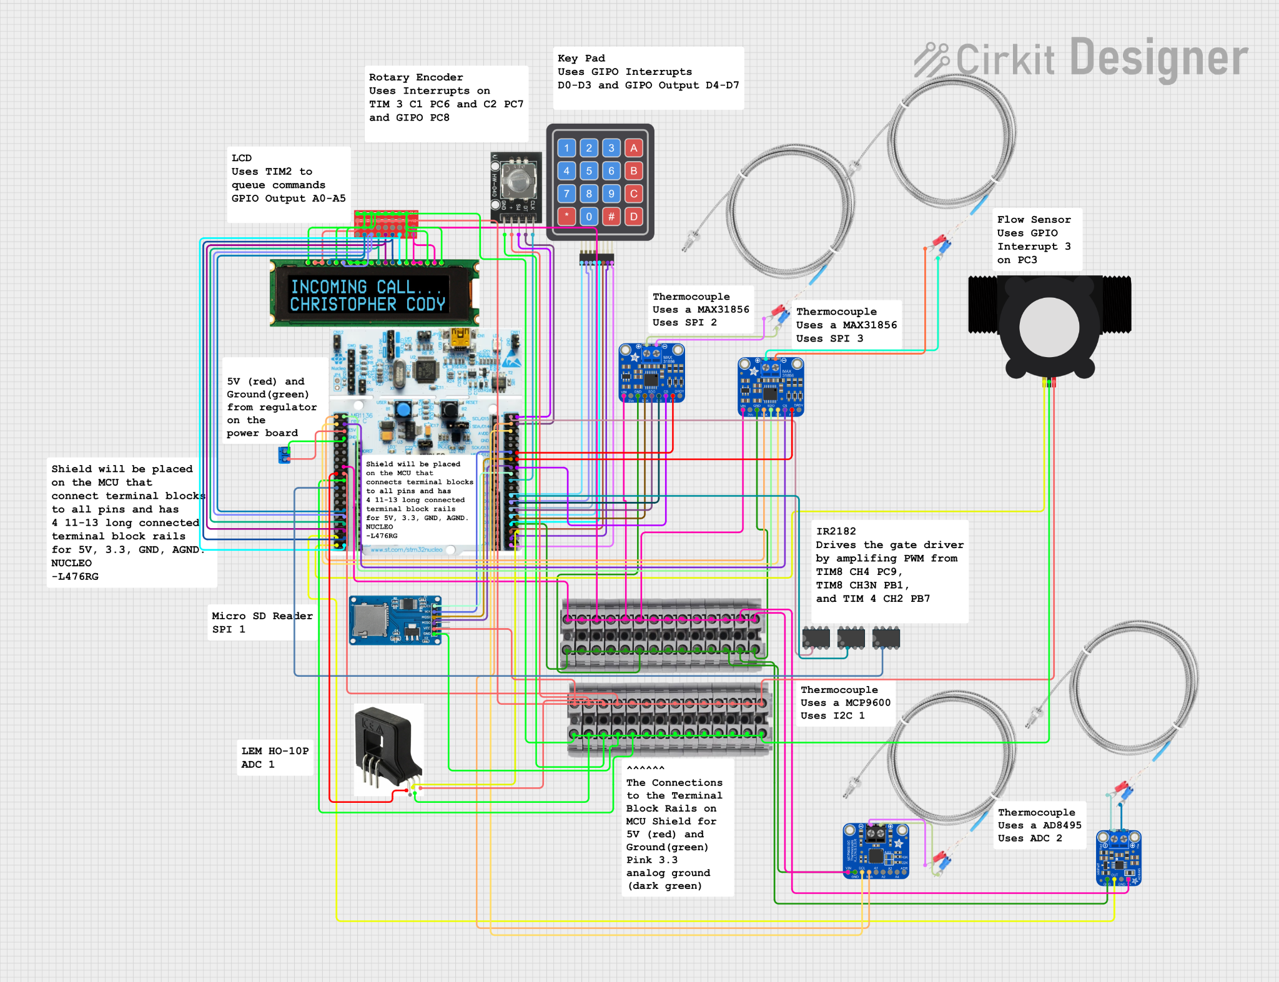
Detailed Design - Embedded
Connects all Subsystems
Interfaces with Sensors
Interfaces with the User
Runs the Logic for PID Controller
Displays Faults from Safety System
Logs System Vials

Slide 27
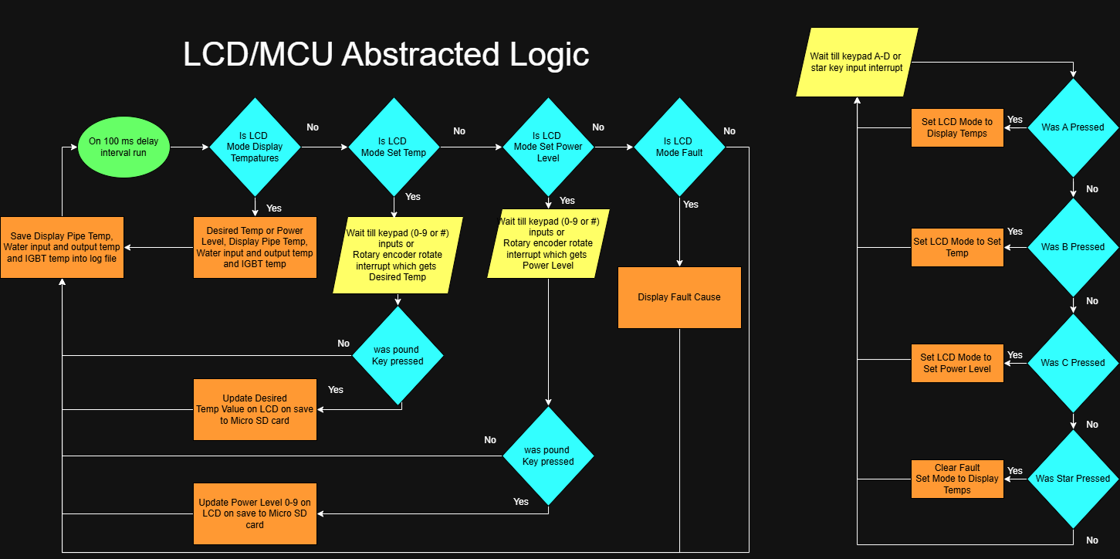
Detailed Design - Embedded

Slide 28
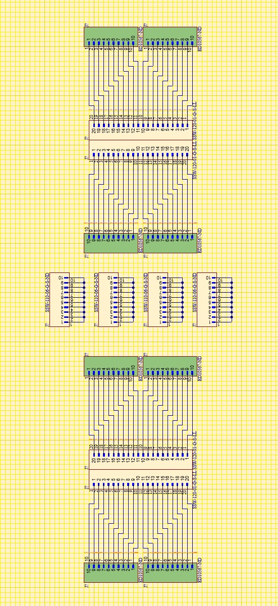
Detailed Design - PCB
Supports All Subsystems
Routes Sensor Feedback Signals
Interfaces with User I/O Hardware
Provides Power and Isolation Between Domains
Carries Fault and Protection Signals
Organizes and Distributes System Level Connections

Slide 29
Statement of Contributions
Aaron Neuharth - Detailed Design Safety, Conceptual Design
John Donnell - Detailed Design PCB, Hardware Block Diagram
Austin DuCrest - Detailed Design Power, Constraints
Dow Cox - Detailed Design Embedded, Component Temp Constraint
Cole Wilson - Detailed Design Heat Controls, Background, Specs

